Slide 1
Electricity Bill Management System
Haoyu Huang, CISC 4900 VC1B

Slide 2
Project goal and topic
project entitled “Electricity Billing System” aim is to generate electricity bill with all the charges and penalty.
I used Python 3.8 as front end and MySql-marriaDB engine as back end for developing our project. My project is independent of any OS and can run on any platform.
The overall project report is divided into further sub-parts which includes developing of the model system with scope for enhancement depending on the functionality of the organisation.

Slide 3
In-Built & User created modules
Inbuilt modules :
• sys
• mysql-connector
• os
• json
• math
• smtplib
• email
• datetime
• csv
• hashlib
• time
• cProfile
• re
• pyinstaller

Slide 4
In-Built & User created modules
Custom (user made) Modules
• adminBillGen
• clearscreen
• customerView
• billEmail
• billGen
• login
• logout

Slide 5
Table Structure
Table Name | Customer |  | Table | Login
Field Name | Type |  | Field Name | Type
id | integer |  | id | int
meterno | integer |  | userid | varchar()
consumerno | biginteger |  | branch | text
consumername | varchar() |  | session_in | datetime
load_con | varchar() |  | session_out | datetime
unit_consumed | integer |  | dept_no | int
month | varchar()
year | integer
email | varchar() |  | Table | User
address | text |  | Field Name | Type
amountgen | decimal |  | id | int
 |  |  | username | varchar()
 |  |  | password | varchar()
Table Name | DEPT |  | branch | varchar()
Field Name | Type |  | dept_no | int
id | int |  | useradmin_id | varchar()
dept_no | int
deptname | text

Slide 6
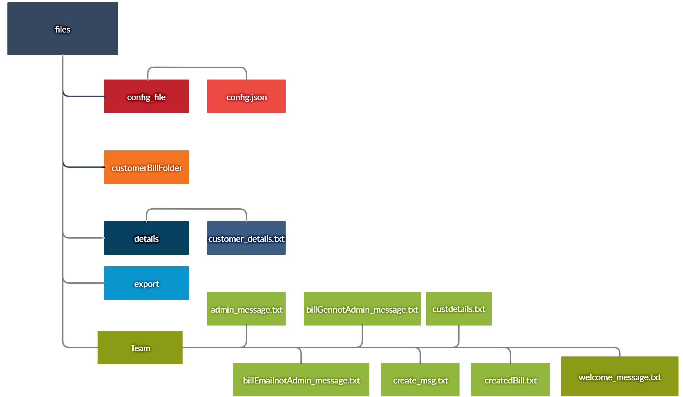
Working description

Slide 7
Divide into 4 sub-part
Admin : Its part has the privileges of a super user. It has the power to create, delete and edit, etc.
Bill Generation : This module has been designed to generate electricity bills based on the inputs of meter reading.
Bill Delivery : This module will email the bill to respective customers address and thus bring the concept of a reduce paper and reduce carbon footprint making the environment greener and sustainable.
Customer View Bill : This portal is only for use by the consumer to view the bill for the current month.

Slide 8
Program codes
mainRun.py
from datetime import datetime
from os import system
from login import welcome_message # Assuming the login module is imported from a separate file
from clearscreen import clear # Assuming the clearscreen module is imported from a separate file
import mysql.connector as c
connection = c.connect(host='localhost', database='electricity_bill', user='root', password='')
db = connection.cursor()
clear() # Clear the screen before proceeding
# Update the session out field in the login table with the current timestamp
db.execute(f'UPDATE login SET session_out="{datetime.now()}" WHERE session_out="0000%"')
connection.commit()
welcome_message() # Display the welcome message

Slide 9
Program Codes
login.py
import hashlib
import json
import time
from datetime import datetime
from os import path
import mysql.connector as c
# Database connection
connection = c.connect(host='localhost', database='electricity_bill', user='root', password='')
db = connection.cursor()
# Read configuration parameters
with open('files/config_file/config.json', 'r') as c:
params = json.load(c)["params"]
# Welcome message
def welcome_message():
clear()
print(open('files/messages/welcome.txt', 'r').read().format(params['company_name']))
login_deptno()

Slide 10
login.py Continue
# Login system
def login_deptno():
while True:
try:
deptno_in = int(input('Please enter the department no.\n'))
if deptno_in == 15675812:
consumerDetails()
else:
logincheck(deptno_in)
break
except ValueError:
print('\nPlease recheck department no (Tip: Enter all numbers not alphabets!)')
def logincheck(deptno):
# Check if the department number exists in the database
db.execute('SELECT dept_no FROM dept')
deptno_dict = {i[0] for i in db.fetchall()}
newline = '\n'
if deptno not in deptno_dict:
login_deptno(f'{deptno} Department No is invalid{newline}Please enter a valid department no!!')
else:
login_user(deptno)

Slide 11
login.py Continue
def login_user(deptno):
clear()
print('\nNow please enter your login credentials')
print('---------------------------------------')
userid = input('Please enter your USERID\n')
print('---------------------------------------')
password = input('Please enter your password\n')
hashpass = hashlib.md5(password.encode()).hexdigest()
# Check if the entered credentials exist in the database
db.execute(f'SELECT * FROM user WHERE password="{hashpass}" AND dept_no="{deptno}" AND useradmin_id="{userid}"')
query = db.fetchall()
if query is None or query == []:
print('The given credentials were wrong')
print('Please wait for 2 sec!')
time.sleep(2)
welcome_message()
else:
login_user_in(userid, hashpass, deptno)

Slide 12
login.py continue
def login_user_in(userid, hashpass, deptno, work=None):
logintime = datetime.now()
db.execute(f'SELECT branch FROM user WHERE useradmin_id="{userid}"')
branch = db.fetchall()[0][0]
if work is None:
# Insert the login details into the login table
db.execute(f'INSERT INTO login(userid, branch, session_in, dept_no) VALUES("{userid}", "{branch}", "{logintime}", "{deptno}")')
connection.commit()
else:
# Update the session time for an existing login
db.execute(f'UPDATE login SET session={datetime.now()} WHERE userid="{userid}" AND session_out="0000%"')
branchget = userid.split("#")
print('Please wait, you are being redirected there! in 5 sec.....')
time.sleep(5)
# Redirect to the appropriate branch based on the user's branch
if branch == 'ADMIN':
adminHome(userid, logintime)
elif branch == 'BILL GENERATION':
bilGenHome(userid, logintime)
elif branch == 'BILL DELIVERY':
bilEmailHome(userid, logintime)
welcome_message()

Slide 13
Logout.py
import sys
import time
from datetime import datetime
import mysql.connector as c
from clearscreen import clear
connection = c.connect(host='localhost', database='electricity_bill', user='root', password='')
db = connection.cursor()
def logout(userid):
# Update the session_out field in the login table with the current timestamp for the given user
db.execute(f'UPDATE login SET session_out="{datetime.now()}" WHERE userid="{userid}" AND session_out="0000%"')
connection.commit()
clear() # Clear the screen
print(f'You have been logged out!!! {userid}')
print('The window is closing in 2 seconds')
time.sleep(2) # Wait for 2 seconds
clear() # Clear the screen again
sys.exit() # Exit the script

Slide 14
Clearscreen.py
from os import name, system
def clear():
# Check the name attribute to determine the operating system
if name == 'nt': # 'nt' represents Windows
_ = system('cls') # Use 'cls' command to clear the screen in Windows
else:
_ = system('clear') # Use 'clear' command to clear the screen

Slide 15
customerview.py
import mysql.connector as c
import datetime
from os import path
import json
import sys
import time
from clearscreen import clear
# Database connection
connection = c.connect(host='localhost', database='electricity_bill', user='root', password='')
db = connection.cursor()
# Get the file path for the config.json file
THIS_FOLDER = path.dirname(path.abspath(__file__))
my_file = path.join(THIS_FOLDER, 'files', 'config_file', 'config.json')
# Read configuration parameters
with open(my_file, 'r') as c:
params = json.load(c)["params"]

Slide 16
customerview.py continue
def consumerDetails():
clear() # Clear the screen
# Retrieve the existing consumer numbers from the database
db.execute('SELECT consumerno FROM customer')
detailsconsumerno = {i[0] for i in db.fetchall()}
mydate = datetime.datetime.now()
while True:
try:
consumerno = int(input('Please enter your consumer no.\n'))
except ValueError:
print("\nPlease enter a valid consumer no")
if consumerno not in detailsconsumerno:
print('\nThe consumer no does not exist!! \nPlease enter a valid consumer no')
else:
break

Slide 17
Customerview.py continue
# Retrieve customer details for the given consumer number and current month
db.execute(f'SELECT * FROM customer WHERE consumerno={consumerno} AND month="{mydate.strftime("%B")}"')
custdetails = db.fetchone()
if custdetails[-1] == 0:
print('No bill has been generated for this month!')
else:
my_file1 = path.join(THIS_FOLDER, 'files', 'messages', 'custdetails.txt')
with open(my_file1, 'r') as c1:
fileread = c1.read()
# Format the template with customer details and print it
print(fileread.format(params['company_name'], custdetails[3], custdetails[1], custdetails[2],
custdetails[4], custdetails[5], custdetails[-1], custdetails[8], custdetails[9]))
print('\nPress any key to exit!!!')
input()
print(f"Thank you for using the {params['company_name']} ELECTRICITY CUSTOMER DEPARTMENT SERVICES")
time.sleep(2)
sys.exit()

Slide 18
Calculation of Bill in BillGen.py
def Bill_Calc1(unit):
meter = 10 # Meter Rent
MVCA = 60 # Meter Load charge
fixedChrge = 100 # This is the fixed charge
untstr = str(unit)[-1] # This is the Adjustment Charges
if unit >= 1 and unit <= 50: # between 1 - 50 units
amountgen = ceil(unit * 4.89) + meter + MVCA + fixedChrge + int(untstr) - 1
rebate = 1
aduj = untstr
elif unit > 150 and unit <= 250: # between 150 - 250 units
amountgen = ceil((50 * 4.89) + ((150 - 50) * 5.4) + (unit - 150) * 6.41) + meter + MVCA + fixedChrge + int(untstr) - 1.5
rebate = 1.5
aduj = untstr
elif unit > 250: # above 250 units
amountgen = ceil((50 * 4.89) + ((150 - 50) * 5.4) + ((250 - 150) * 6.41) + (unit - 250) * 7.16) + meter + MVCA + fixedChrge + int(untstr) - 1.6
rebate = 1.6
aduj = untstr
else:
amountgen = 0
rebate = 0
aduj = 0
return amountgen, rebate, aduj

Slide 19
Methond send email to customer in billEmai.py
def sendmailtocustomers(userid, logintime):
# Establish SMTP connection
server = smtplib.SMTP_SSL('smtp.gmail.com', 465)
server.login(params['email'], params['password_email'])
month = datetime.now().strftime('%B')
# Retrieve customer data from the database
db.execute(f'SELECT email, consumername, consumerno FROM customer WHERE month="{month}"')
data = db.fetchall()
success_count = 0
error_count = 0
for email, consumername, consumerno in data:
subject = f"Your electricity bill has been generated for the month {month} ({consumername})"
# Retrieve the unit consumed for the customer
db.execute(f'SELECT unit_consumed FROM customer WHERE month="{month}" AND consumerno="{consumerno}"')
unitsConsumed = db.fetchone()[0]
try:
# Read the bill content from file
with open(f'files/customerBillFolder/{unitsConsumed}{consumerno}.txt', 'r') as bill_file:
bill_content = bill_file.read()
# Create the email message
message = MIMEMultipart()
message['From'] = params['email']
message['To'] = email
message['Subject'] = subject
message.attach(MIMEText(bill_content, 'plain'))
# Send the email
server.send_message(message)
success_count += 1
print(f"Email (BILL) sent to {consumername}")
except Exception as e:
# Handle any exceptions that occur during email sending
error_count += 1
print(f"There was an error sending the email to {consumername}:", str(e))
# Close the SMTP connection
server.quit()

Slide 20
admin_message.txt
___________________________________________________________________________
WELCOME TO ADMIN HOMEPAGE OF {} ELECTRICIY DEPPARTMENT
___________________________________________________________________________
USERID : {}
LOGIN TIME: {}
CURRENT TIME: {}
WHAT YOU WANT TO DO?
___________________________________________________________________________
SL NO. | FUNCTIONS AVAILABLE | FUNCTIONS CODE----------------------------------------------------------------------------------------------------------------------
(1). | REGISTER OPERATOR | 01#01
(2). | DELETE OPERATOR | 05#02
(3). | CHECK ALL THE CUSTOMER DETAILS | 06#03
(4). | CHECK THE BILL GENERATION DEPARTMENT | 02#01
(5). | CHECK the OPERATOR DETAILS | 07#44
(6). | INSERT NEW CUSTOMERS USING CSV FILES | 03#01
(7). | CHECK THE BILL DELIVERY DEPARTMENT | 04#01
(8). | LOGOUT | 00#01
--------------------------------------------------------------------------------------------------------------------------
NOW PLEASE ENTER THE FOLLOWING FUNCTION NO IN ORDER TO EXECUTE A TASK.

Slide 21
billEmailnotAdmin_message.txt
___________________________________________________________________________
WELCOME TO BILL DELIVERY (EMAIL) DEPARTMENT GENERATION HOMEPAGE OF {} ELECTRICIY DEPPARTMENT
___________________________________________________________________________
USERID : {}
LOGIN TIME: {}
CURRENT TIME: {}
CURRENT MONTH NAME : {}
WHAT YOU WANT TO DO?
___________________________________________________________________________
SL NO. | FUNCTIONS AVAILABLE | FUNCTIONS CODE
--------------------------------------------------------------------------------------------------------------------------
(1). | SEND THE BILLS TO CUSTOMERS FOR THIS MONTH | 01#02
(2). | LOGOUT | 00#01
--------------------------------------------------------------------------------------------------------------------------
NOW PLEASE ENTER THE FOLLOWING FUNCTION NO IN ORDER TO EXECUTE A TASK.

Slide 22
create_msg.txt
The user is created with the following credentials:
USERNAME : {}
PASSWORD : {}
BRANCH : {}
DEPARTMENT NO : {}
USERADMIN ID : {}

Slide 23
createdBill.txt
Consumer Name : {}
Meter No : {}
Consumer No : {}
Meter Load : {}
Units Consumed : {}
Meter Rent : $10
MVCA : $60
Fixed Charge : $100
Rebate : ${}
Adjustment Charges : {}
Net Amount Payable : $ {}
Email : {}
Address : {}

Slide 24
custdetails.txt
--------------------------------------------------------------------------------------------------------
{} ELECTRICITY CUSTOMER DEPARTMENT
--------------------------------------------------------------------------------------------------------
Consumer Name : {}
Meter No : {}
Consumer No : {}
Meter Load : {}
Units Consumed : {}
Net Amount Payable : {}
Email : {}
Address : {}

Slide 25
welcome_message.txt
Welcome to the {} ELECTRICITY BILL MANAGEMENT
The following departments are available for the login.
SLNO.| DEPARTMENT NAME | DEPARTMENT NO.
___________________________________________________________________________
(1). | ADMIN (SUPERUSER) | 156758
(2). | ELECTRICITY BILL GENERATOR | 145759
(3). | ELECTRICITY BILL DELIVERY | 145761
(4). | CUSTOMER VIEW BILL SERVICES (ONLY CONSUMERS) 15675812
___________________________________________________________________________
PLEASE ENTER THE RESPECTIVE DEPARTMENT NO. IN THE INPUT FIELD GIVEN BELOW

Slide 26
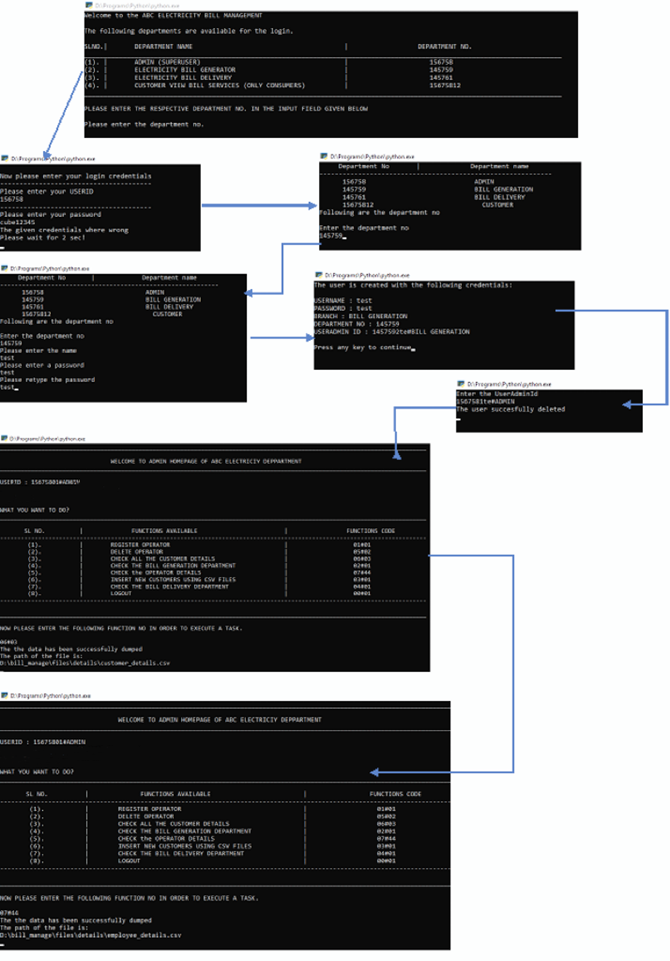
Admin Console Screen Shots

Slide 27
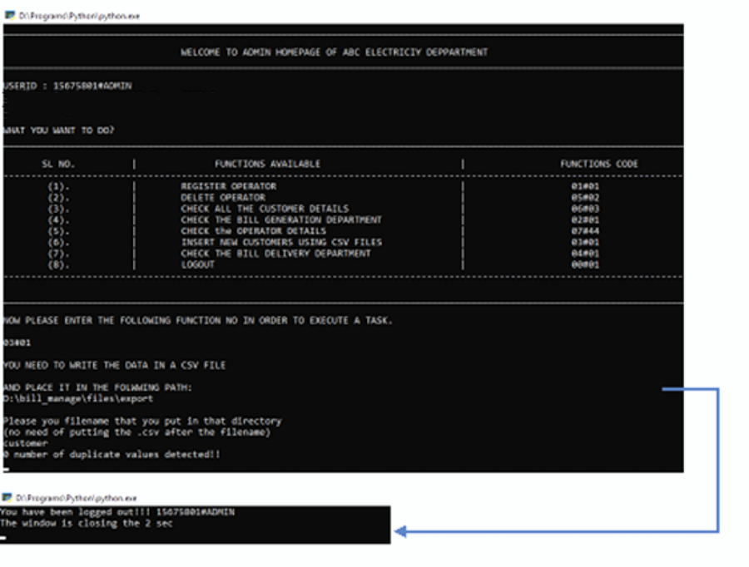
continue

Slide 28
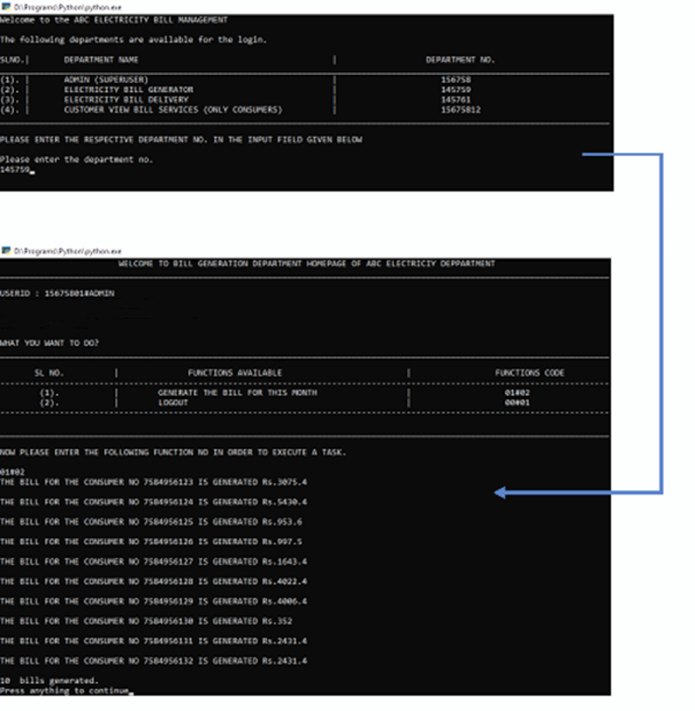
Bill generation screenshot

Slide 29
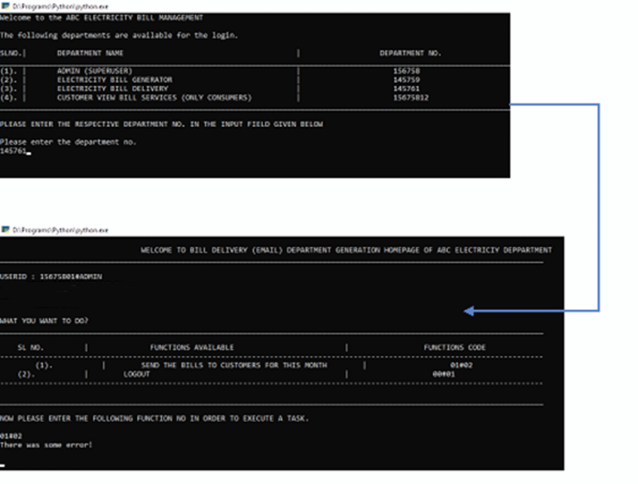
Bill Emailing screenshot

Slide 30
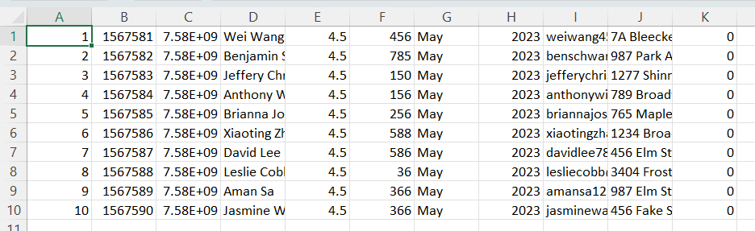
customer.cvs

Slide 31
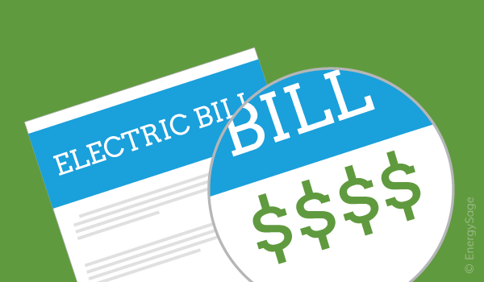
End

Slide 32
Bibliography
https://www.codewithharry.com/
https://www.geeksforgeeks.org/
https://www.python.org/doc/
https://stackoverflow.com/
GitHub Source Codes:
https://github.com/haoyuhuang0817/electricity-bill-system/tree/main/electricity%20bill%20management(final)

